Slide 1
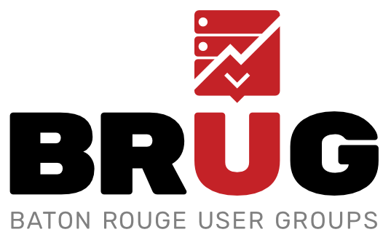
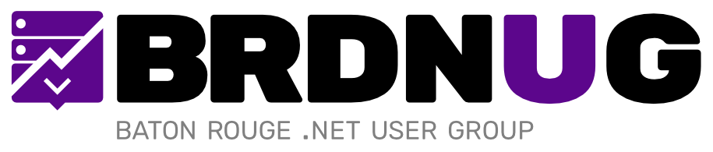
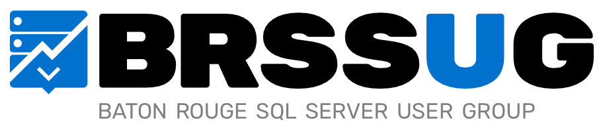

Slide 2
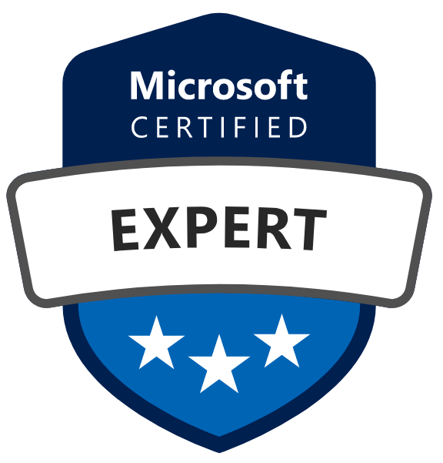
New Azure Certifications 101
William Assaf, Principal Consultant, Sparkhound

Slide 3

We are thrilled to say the first ever PASS Virtual Summit will be taking place this November!
We will be launching PASS Summit into a whole new world, and with that comes exciting opportunities with what we can offer you. We will go beyond simply moving sessions online to fully embracing everything a virtual environment can offer.
Find out more at PASS.org/summit

Slide 4
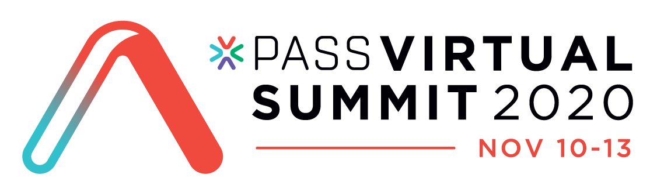
Take Your Career to New Heights
Save $50 USD
Register for PASS Summit 2020 and you can save $50 USD the registration price.
To claim use code LGDISMGY5
* Unique discount code cannot be applied retroactively and cannot be combined with any other offers.

Slide 5
Certified Technology Professionals
Certified employees are 17% more productive.
Certified reduce unplanned downtime when problems arise by 56%
Certified employees are generally more satisfied with their jobs and enjoy tenures that are 15% longer than uncertified employees.
72% of employers require IT certifications for certain job openings
60% of employers use certifications to confirm subject matter expertise.
Microsoft Learning White Paper http://download.microsoft.com/download/9/4/B/94B5442E-0494-4B42-A5DC-8742E4254B09/BVW-Microsoft-US40548315.pdf
CompTIA HR Perception of IT Training and Certification Study: 2015 https://certification.comptia.org/docs/default-source/downloadablefiles/hr-perceptions-of-it-training-and-certification.pdf
Notes:
<read notes instead>
Here are some statistics from both Microsoft and CompTIA talking about employees who are certified being more productive, responding better, having better careers, being respected by employers.
Does a certification make you a better database administrator per se? No, I’m not implying causation here, but the process of preparing for an exam, the preparation of the materials, and the mindset that led you to the self-improvement path of the certification exams, those are all productive, causative, and beneficial for your career. So good for you for attending this session today and probably feeling the need to get certified.
A final note I’d say is that becoming certified makes your skillset broader, more aware, and better at choosing the right solutions for the right problems.

Slide 6
Azure Certs
What have they done with my MCSD/MCSE/MCSA?
What path of cert exams do I have now?
How do I take an exam while *waving arms around* all this is going on?
Notes:
Today in the short time I have available I aim to answer three questions.
<click>
<Read slide>
<click>
<Read slide>
<click>
<Read slide>

Slide 7
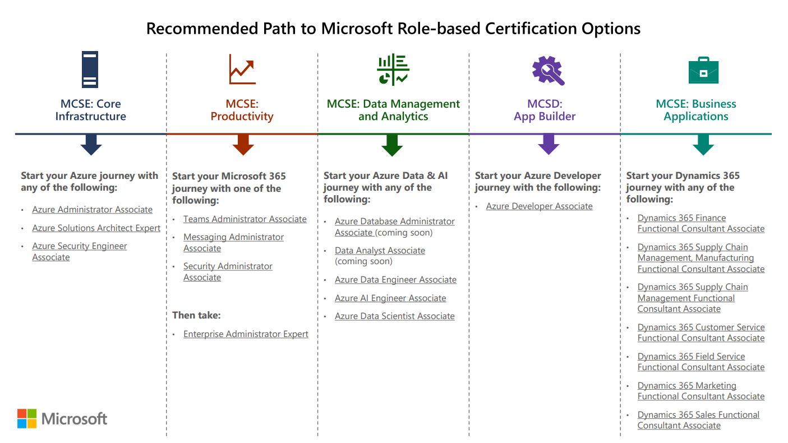
Role-based certs have replaced older certs
Notes:
So, first, What have they done with my MCSD/MCSE/MCSA?
If it starts with 70-, the exam is almost certainly already retired or will be retired by January 2021. That deadline was actually moved back six months because of COVID-19! This includes all exams associated with MCSA MCSD and MCSE, tho, the certifications themselves will remain on your official Microsoft transcript until no later than June 2022. Over the past few years, exams starting with letters like AZ, DP, AI, for example, are the newer exams you’re looking for.
Those older exams we’ve had all along were technology or platform based. Now, Microsoft exams are role based.
There will not be Windows Server 2019 and SQL Server 2019 certifications for those products, instead, there will be exams focusing on roles, like Solutions Architect, Enterprise Administrator, Azure Data Engineer, Azure Developer, Functional Consultant, etc. These roles are expected to have broad experience with all their relevant features and products.

Slide 8
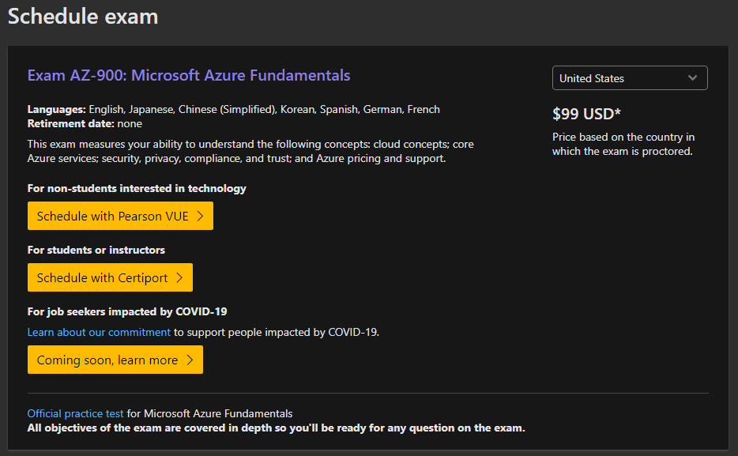
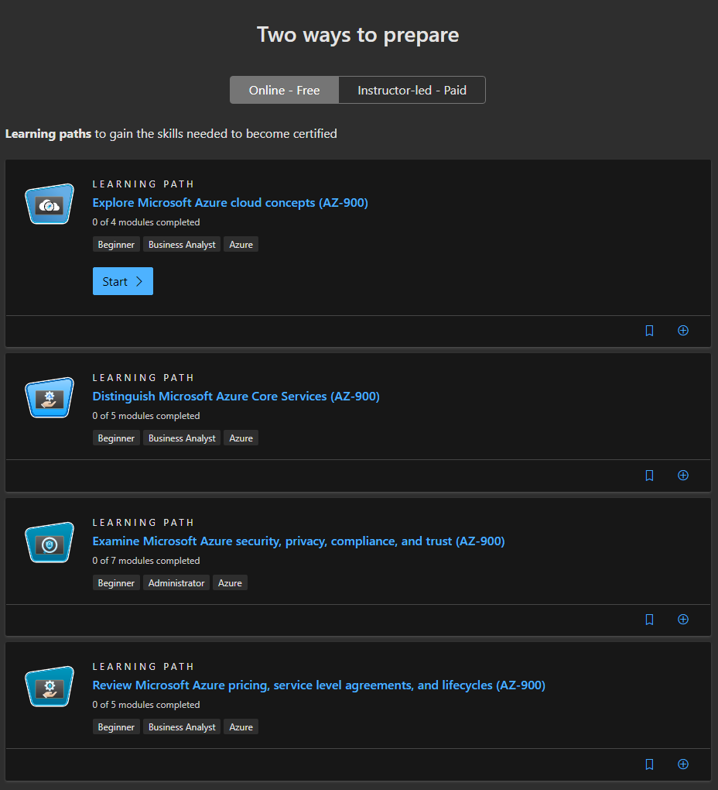
For everyone, AZ-900 is a great start
https://docs.microsoft.com/learn/certifications/exams/az-900
Notes:
Ok, second question, what path should go get on.
AZ-900 is a Fundamentals level exam, which means its geared towards people entering the technology, even if they have years of technical experience with other Microsoft products. I took AZ-900 for example and in the process I learned a lot about features and solutions available outside of the products in Azure I typically work in. Think of Azure as an entire new ecosystem to work in, AZ-900 is the perfect introduction for everyone whether you are a developer, sysadmin, DBA, or support tech.
<click>
When you go to the website for AZ-900, you get all the links you need to get started right away, for registering for the exam, or for paid training or practice exams. But before you go pay for training,
<click>

Slide 9
For everyone, AZ-900 is a great start
https://docs.microsoft.com/learn/certifications/exams/az-900
Notes:
…many of exam sites on Microsoft Learn also includes free self-driven learning content. These free Learning Paths are available for many cert exams right now to guide you through the entire exam syllabus, with product info, sample questions for review, important differences, infographics, even with free Azure time via temporary sandboxes that let you create the actual services and servers in the browser. You do not have to spend a dime on training yourself up for Azure certs, Microsoft provides everything for you.
I personally used the Learning Paths, plus my own experience, to pass AZ-900. And, my opinion, I found the free Microsoft Learning Paths faster and more focused than some of the video series offerings in the MOOC, or Massive Open Online Course platforms.

Slide 10
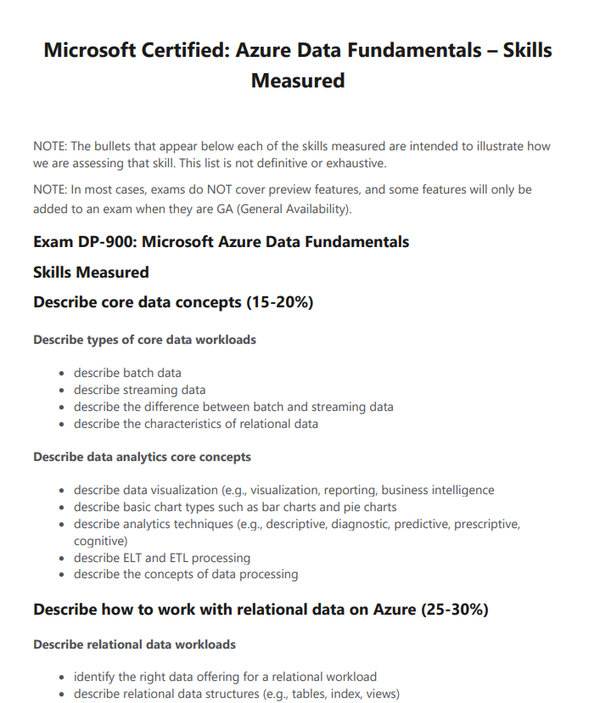
What Is On a Cert Exam?
https://docs.microsoft.com/en-us/learn/certifications/azure-data-fundamentals
Notes:
If you’re curious what is on each of these exams, straight from Microsoft.com, this provided is the “Skills Measured” section of an exam’s website, this is the “domain”.
The “domain” is determined by a group of SMEs before item writing begins, and is validated by their real-life experience in the field. You know going in how much of the exam will be able each topic, and the specific topics covered, so there’s no surprises.

Slide 11
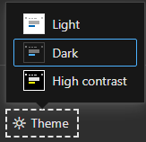
Docs.Microsoft.com Dark Theme
Notes:
By the way, if you’re wondering why my screenshots were so dark, it’s because Microsoft Docs now has a built in Dark Theme you can enable. Scroll down, look in the bottom left hand corner, and enjoy.

Slide 12
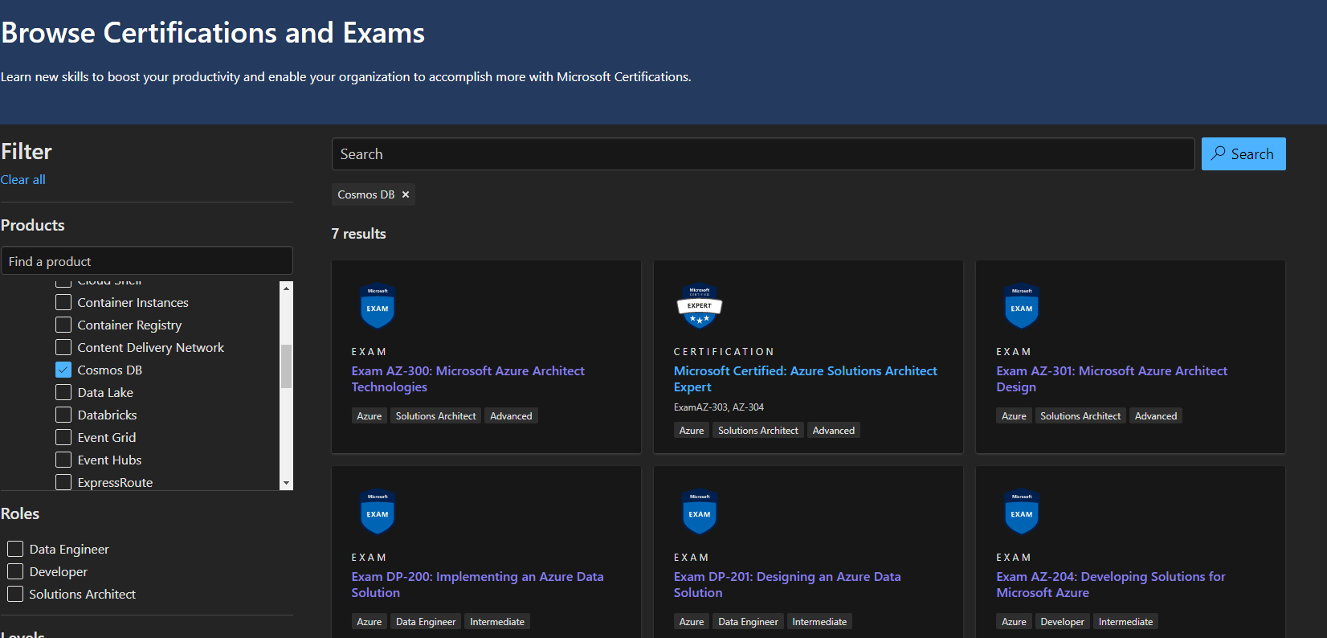
Browse Exams and Certs
Use Product Finder to locate exams for your technology. https://docs.microsoft.com/learn/certifications/browse/
Notes:
The Browse Certs and Exams page allows you to search for exams or certs by technical topic, like Azure SQL DB or Cosmos DB or Event Hubs or Containers or SharePoint Online. It’s easy to decide what to focus on next. You can also search by job role or job level.
But let’s go over some of the exams for roles that are probably watching this presentation.

Slide 13
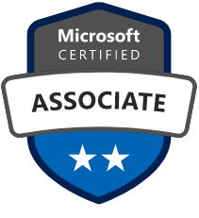
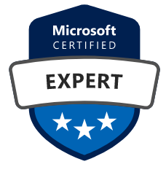
Dev Folks
Azure Developer Associate
AZ-204: Developing Solutions for Microsoft Azure https://docs.microsoft.com/learn/certifications/exams/az-204
Then:
Azure Solutions Architect Expert
AZ-303, AZ-304
DevOps Engineer Expert
AZ-400
IoT Developer Specialty
AZ-220
Notes:
For you developers who work in Azure, the certification you’re going for starts with exam AZ-204. A full third of AZ-204 is connecting to and using Azure services, but there’s also content on the various server and serverless compute options, security, storage, and monitoring. It tests what you need to know to, for example, to connect various services together to deploy an app on VM or in an Azure App Service. After AZ-204, you can go into Solutions Architect and DevOps
<click>
Then, with that prerequisite out of the way, you’re ready to move on to the next levels for Azure Certs for Developers, including the Solutions Architect or DevOps Engineer exams. There is free learning pathway content, with sample questions, available on the website for the exam for AZ-400, for example. AZ-400 covers container architecture, instrumentation, security and compliance, source control, collaboration and continuous integration, as well as delivery and release management.
<click>
If you’re working in the Internet of Things space, there’s an Azure cert for that too, including the Azure IoT service as well as Edge design , networking, debugging, and security.
Note that these Azure Dev exams aren’t exactly new, in fact, a couple of architect role Azure cert exams will retire at the end of September 2020, including AZ-300 and AZ-301. Those two exams have been replaced by AZ-303 and AZ-304.

Slide 14
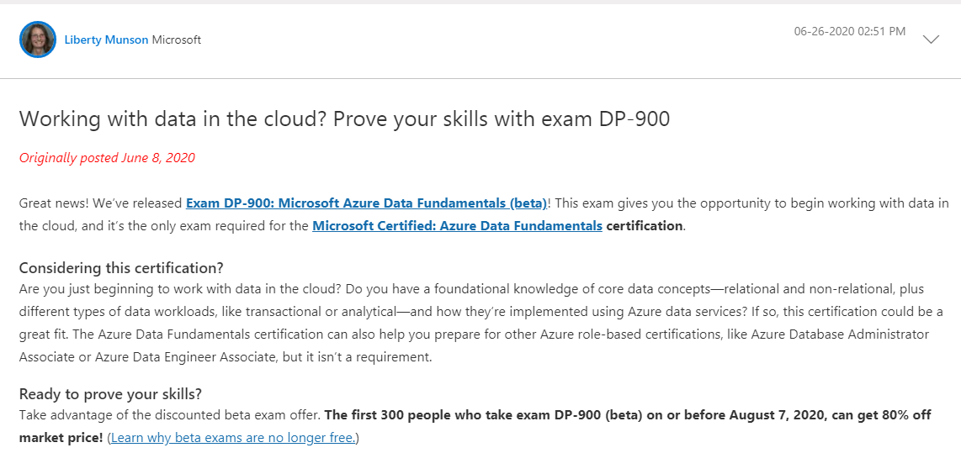
Beta Exams
Watch the Microsoft Learn Blog https://techcommunity.microsoft.com/t5/microsoft-learn-blog/bg-p/MicrosoftLearnBlog
Notes:
And, there’s more roles to come. In fact, when new Microsoft cert exams first come out, they’re available to take super cheap (they used to be free, now they’re maybe $20) in beta format, so are relatively risk free. The only catch is that you don’t find out if you pass for a couple months. But Beta Exams Count if you pass them, once they go live. If you don’t pass, you can re-take it when it goes live, just as you would normally. Beta exams are usually limited to a few hundred candidates in English-speaking countries.
<click>
Watch the Microsoft Learn Blog for beta exam announcements. They’re usually posted by Liberty Munson, Microsoft’s long-time cert exam psychometrician. For example, here’s the announcement for the beta for DP-900 in early June, along with a code that works for the first 300 candidates to register for the exam. I got into the beta for cheap, took it and didn’t get my results until two months later in August.

Slide 15
Database Folks
Azure Data Fundamentals
DP-900
Azure Data Engineer Associate
DP-200, DP-201
Azure Database Administrator Associate
DP-300
Notes:
If you are a developer interested in data, or a database admin, or a data analyst, or an AI and Machine Learning analyst, or anything else that works with data in Azure, then DP-900 is the starting point for you. This exam is now out of beta and costs just $99 to take. It’s a Fundamentals-level exam that covers all the basic and current offerings for Azure, it covers both relational and nonrelational offerings, analytical workloads, and all the core concepts surrounding them.
Fundamentals-level exams like AZ-900 and DP-900 are great for learners for Azure, and for broad categories of job descriptions. For example, I am getting everyone on my team of DBAs and Data Analysts to take both AZ-900 and DP-900, it’s a great foundation for working in Azure, so we know what’s possible. But the 900 exams don’t count towards a certification.
<click>
When you get to the doing of the work though, then DP-200 and DP-201 come in. These are for implement Azure data solutions, including relational and nonrelational data options and all the options for ELT and ETL, including Azure Cosmos DB, Azure SQL Database, Azure Synapse Analytics (formerly Azure SQL DW), Azure Data Lake Storage, Azure Data Factory, Azure Stream Analytics, Azure Databricks, and Azure Blob storage.
<click>
There is also a track for folks who send more time administering, securing, configuring, tuning, automating, and monitoring data platforms in Azure, like the three Azure offerings for SQL Server, and also including non-Microsoft products like Azure Database for MySQL or PostgreSQL. DP-300 just came out of Beta and is the clearest possible path for existing SQL DBA’s into a new Azure certification.

Slide 16
Data Science Folks
Azure AI Fundamentals
AI-900
Azure Data Science Associate
DP-100
Azure AI Engineer Associate
AI-100
Notes:
For Data Science professionals, there are a couple paths.
Start with the AI-900 Fundamantals exam, which is directly for folks entering AI even without technical backgrounds, with no data science and software engineering experience are not required. It tests common Machine Learning and AI workloads and how to implement them on Azure, and yes, comes with a free five-part Learning Pathway right there on the website for AI-900.
DP-100 is the first and only Azure exam out right now, but it tests machine learning workloads running in Azure, developing and deploying models, especially in the Machine Learning Service.
Azure AI Engieneers can take AI-100, which certifies the various Microsoft AI solutions and APIs involving natural language processing, speech, computer vision, and conversational AI, as well as the Microsoft Azure Cognitive Services, Azure Bot Service, Azure Cognitive Search, and data storage in Azure.

Slide 17
Power Platform Folks
Power Platform Fundamentals
PL-900
Power Platform App Maker Associate
PL-100
Power Platform Functional Consultant Associate
PL-200
Power Platform Developer Associate
PL-400
Notes:
For Power Platform developers, some of these exams are out, some are in beta, and some will be released by the end of September, for folks who develop applications, integrations, or process automations in the Azure Power Platform.
If you’re not aware, Microsoft really defines a role difference between the Developer and what they call a Functional Consultant. A Functional Consultant has product specific expertise and business consulting, and even inside corporations as an employee, talks in common language to both the business side and IT. So they have created different certification exams for both Developers and Functional Consultants in the power platform, the latter needing to know the capabilities of the platform in order to advise both developers and the business.
Again, the new Microsoft cert exams are role based, not technology based, Functional Consultant is one of these new roles.

Slide 18
Core Infrastructure Folks
Azure Fundamentals AZ-900
Azure Administrator Associate AZ-104
Messaging Administrator Associate MS-203
Teams Administrator Associate MS-700
Security Administrator Associate MS-500
Modern Desktop Admin Associate MD-100, MD-101
Enterprise Administrator Expert MS-100, MS-101
Notes:
For infrastructure folks, again, the first exam we talked about here AZ-900 is the place to start, even if you feel it’s too easy, it will force you to know about things you may not have encountered yet, and might be part of a new solution in the future. I took this exam and I’m a DBA, analysts and developers have taken this exam, admins should take this exam.
<click>
The Administrator exam AZ-104 covers implementing, managing, and monitoring an organization’s Azure Environment, with a lot of content around security and governance, as well as ARM templates. This is as straight forward as it gets to an exam that tests a lot of what Sparkhound offers as an Azure Cloud Reseller and Admin.
<click>
Messaging Administrator Associate covers Microsoft 365 mail, client access and the Outlook Web App, mobile devices, network infrastructure, role-based permissions, Exchange Online and Advanced Threat Protection. The Teams Admin is just that, focused around Microsoft Teams and the Office365 products around it including SharePoint Online, Azure AD, OneDrive, and Groups.
<click>
Security Administrator covers Microsoft 365 enterprise and hybrid environment security, threats and enforcement.
<click>
The Modern Desktop Administrator Associate covers Windows 10 deployment, connectivity, maintenance, profiles and policies, protecting devices and data.
<click>
Finally the Enterprise Administrator Expert follows any one of the Associate level certs and covers two exams on Mobility and Security and Identity Management, put all that together and the Azure Enterprise Admin Expert certification is just three or four exams away.

Slide 19
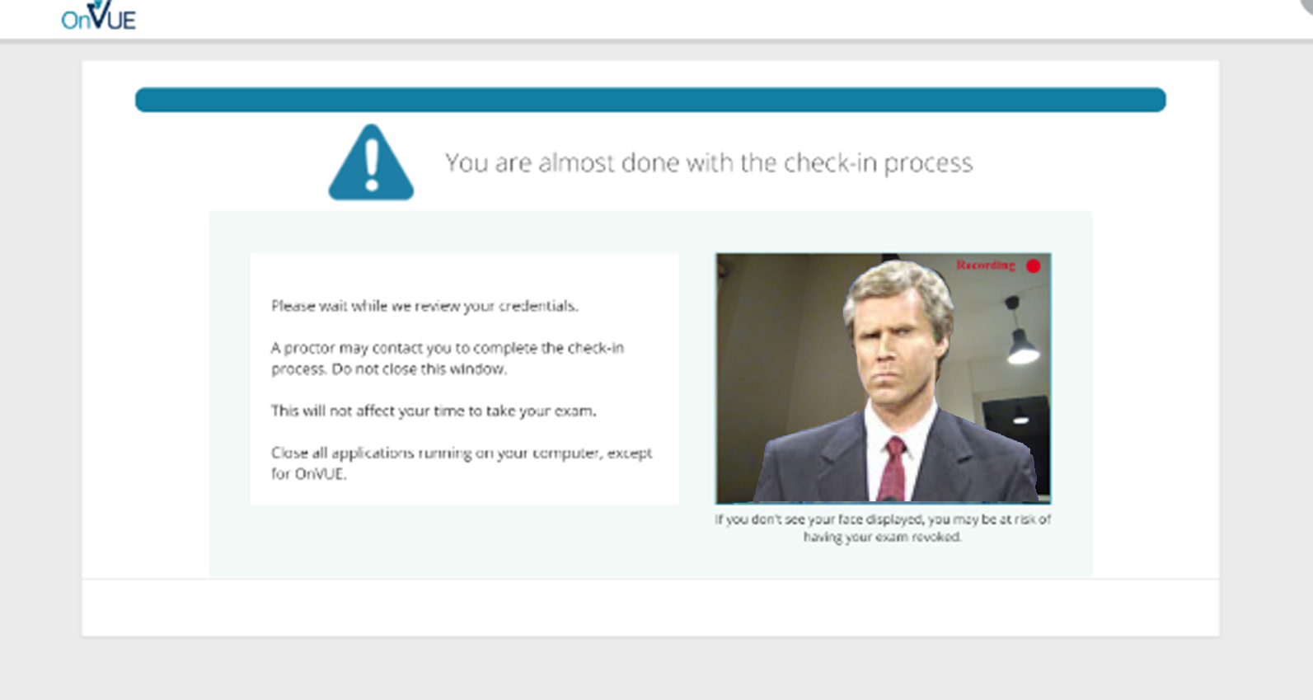
But Right Now? How?
Online Proctored Exams.
Notes:
I’m not going to talk about them tonight because I have limited time but there are also exams for some specific Microsoft platforms like the Dynamics 365 and SAP workloads (if omitted: and obviously a lot of exams for Azure Infrastructure folks).
<click>
So, last question. You’re wondering, with a pandemic, and hurricanes, and between all my hiding under the safety of the covers, how do I take a Microsoft Certification Exam?
Thankfully Pearson VUE and Microsoft had already offered online proctored exams, and now they are expanding this offering’s availability because many testing centers have closed. It’s a live proctored exam, which means you’re taking the exam at your home or office, with someone actively watching you via a webcam and listening to you via your computer. In fact this whole process is easiest if you are taking the exam with a laptop with a built-in webcam.
They for the most part work fine technically, though they are unforgiving.
I have taken three online exams since the pandemic started.
Each time I took an exam, new security requirements were added that became stricter, as they looking for more things.
You have to take pictures of your testing area, from all angles, including the floor and ceiling, your ears and glasses, etc. You have to cover any screens around you, erase any whiteboards, close any window blinds. This remote inspection process may take up to half an hour, so make sure to log into your exam early to give yourself plenty of time to go through their security process, and use the same browser, I recommend using Chrome, throughout.
There are stories out there of people walking through the room behind you, or hearing distant voices, and boom, the remote test monitor fails your exam with no refund. You are warned ahead of time pretty clearly.
So make sure you’re taking your online proctored exam in a place where no one else can be seen or heard, including your kids. I put a sock on my home office door and told my wife and my college kid who is stuck at home, to not make any noise or enter the room for a couple hours. That’s what’s necessary.
Honestly, it’s worked pretty well for me so far, though my boss had issues with a browser and lost his exam slot and had to fight for a refund. Even after the pandemic passes, I might still consider the online proctoring just because it saves hassle and travel. It works well.

Slide 20
Helpful Links
http://www.sqltact.com/2012/04/certification-exams-from-other-side.html
http://www.sqltact.com/2016/07/training-to-do-list-for-new-dba.html
Microsoft Learn Blog: https://techcommunity.microsoft.com/t5/microsoft-learn-blog/
https://docs.microsoft.com/en-us/learn/certifications/posts/mcsa-mcsd-mcse-certifications-retire-with-continued-investment-to-role-based-certifications
https://docs.microsoft.com/en-us/learn/certifications/browse/
Notes:
That’s all I’ve got!

Slide 21

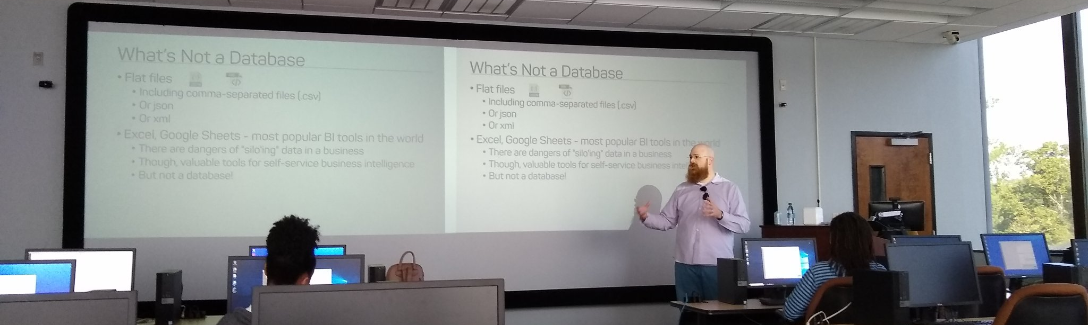
Support your Local STEM Initiatives
I encourage you to find, then donate time and money to local STEM education initiatives where you live. Get involved!
There is almost certainly some nonprofit where you live that needs your enthusiasm and skills to close the achievement gap.
https://www.thewallsproject.org/programs/futures_fund/
Notes:
Here’s a STEM education nonprofit local to me that I volunteer for, please reach out and share your knowledge with the next generation, and especially with folks in your community that are needing to find new careers during the pandemic.
The Futures Fund, an organization I volunteer for and care a lot about, is actually hiring contract web developers to assist and develop online training modules for youth and adult education. If you’re interested in a side hussle with your web dev skills, let me know.

Slide 22
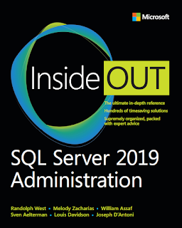
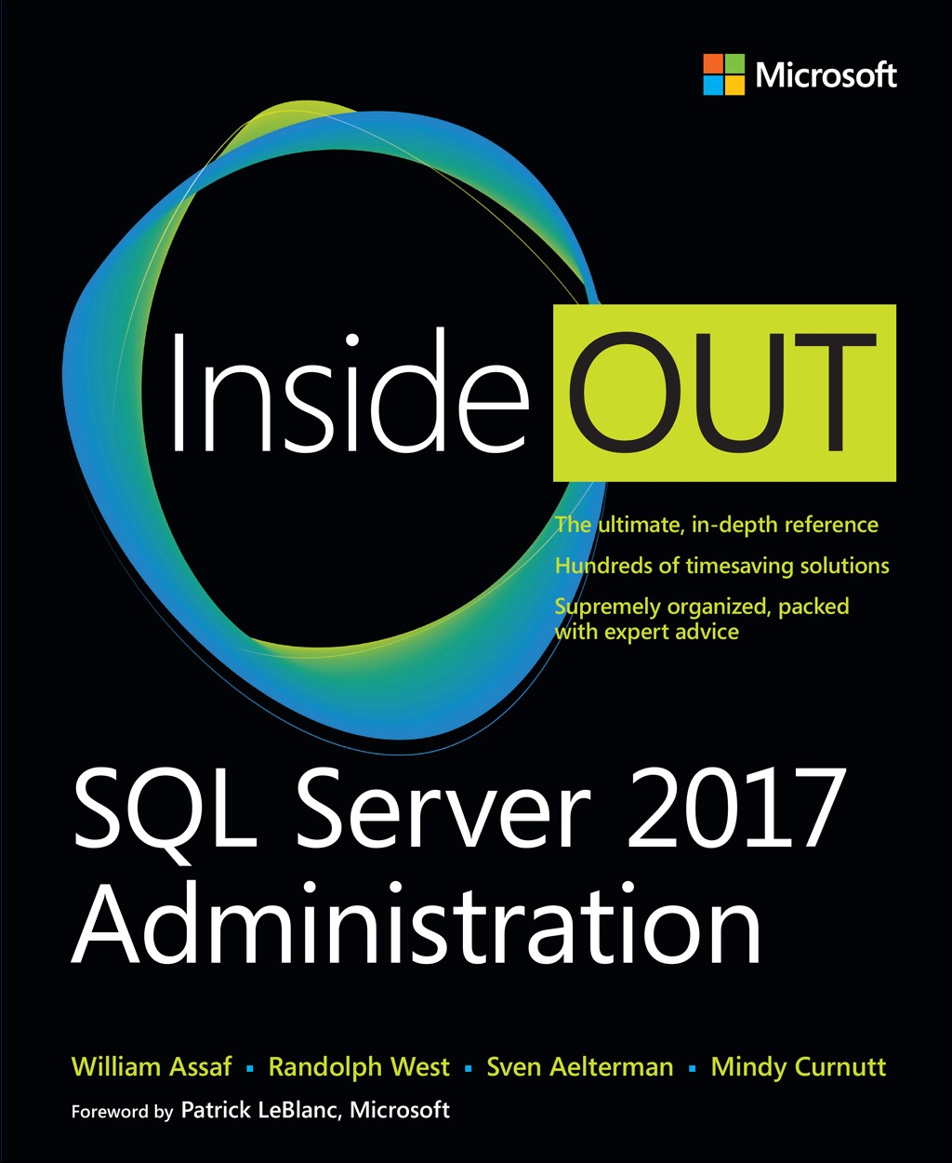
SQL Server 2017 Inside Out
SQL Server 2019 Administration Inside Out
by Microsoft Press
2017 published Feb 2018
2019 published March 2020

Slide 23


William Assaf
Principal Consultant, Microsoft MVP Data Platform
SQLPASS Regional Mentor, SQLSat and UG Co-Organizer in Baton Rouge, La., USA.
Principal Consultant, Sparkhound
SQLTact.com
Co-author, Microsoft Press SQL Server Administration Inside Out 2017 and 2019. MS Cert exam writer since 2012.
linkedin.com/in/williamdassaf
@william_a_dba
Notes:
Here’s a little info about me, I’ll posted this content on my blog at SQLTact.com right after this. Thank you!

